Slide 1
Azure Overview
Notes:
https://courses.cs.washington.edu/courses/cse403/13au/lectures/git.ppt.pdf
http://enos.itcollege.ee/~jpoial/allalaadimised/git/getting-started-with-git.pdf

Slide 2
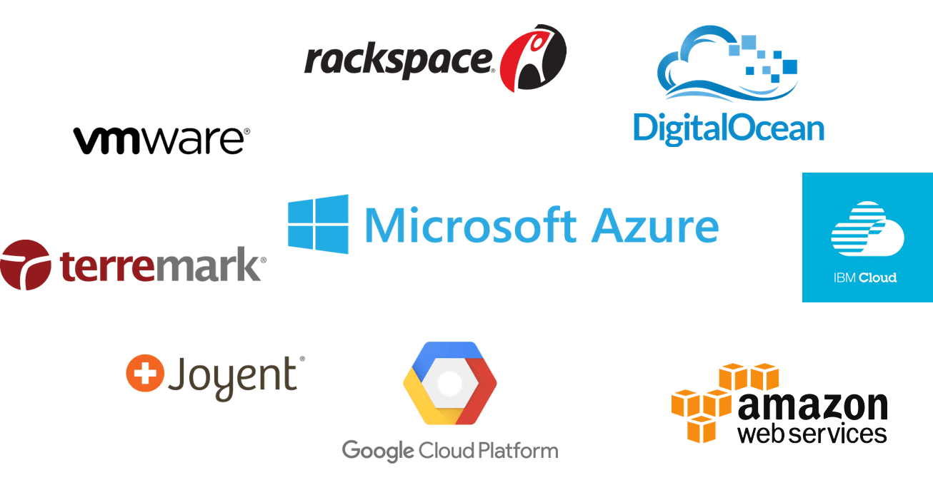
Cloud Service Providers
The Cloud Service is offered by some companies.
These companies are called Cloud Providers.

Slide 3
What is Azure?
A Microsoft’s Cloud Computing Platform
Microsoft buys lot of computers and allow user/s to rent
The maintenance done by Microsoft.

Slide 4

What is Azure?
An ever-expanding set of cloud services
It provides
Software as a service (SaaS),
Platform as a service (PaaS) and
Infrastructure as a service (IaaS)

Slide 5
Azure
Moves Faster
Saves Money
$

Slide 6
Global Footprint

Slide 7

pay only for what you use
🡪

Slide 8
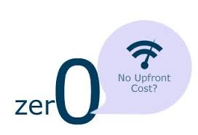
no upfront costs

Slide 9


per minute billing

Slide 10
no charge for stopped VMs
$

Slide 11

on apps, not infrastructure

Slide 12













application building blocks
HDInsight
SQL DB
Storage
Traffic Mgr
Cloud services
Cache
CDN
Active Directory
Web Sites
Mobile
media
Service Bus
BizTalk

Slide 13
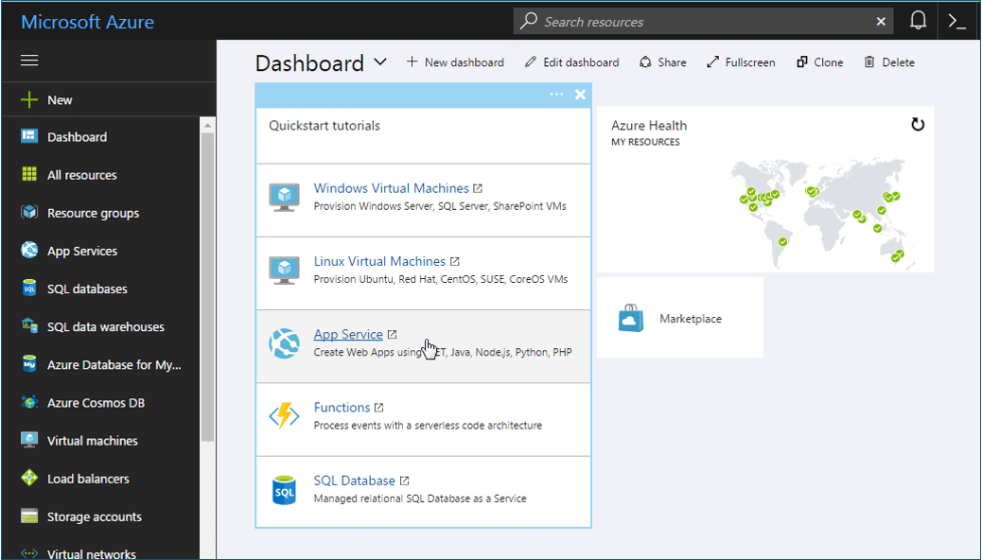
Azure Dashboard

Slide 14
Thanks

